Slide 1
Predicting Necessary Repairs for Wells in Tanzania
Chethan Reddy
Capstone Project

Slide 2
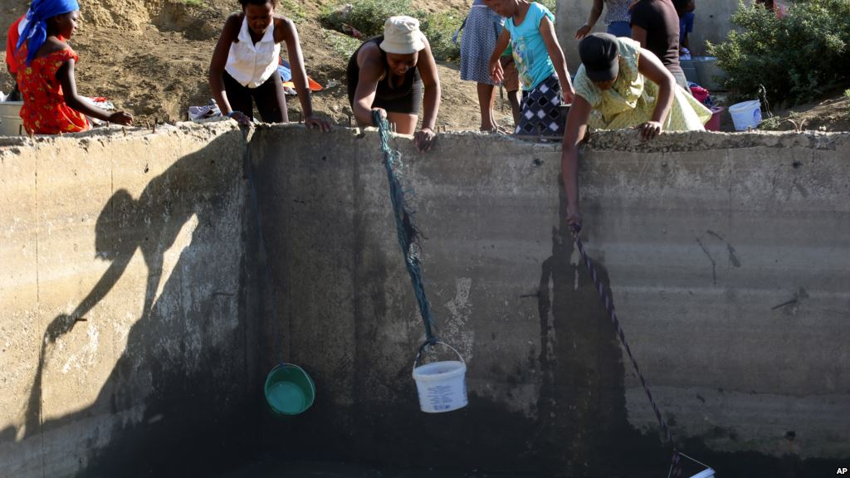
Country in Crisis
23 Million people in Tanzania do not have access to safe drinking water.
Notes:
http://www.wateraid.org/au/where-we-work/page/tanzania

Slide 3
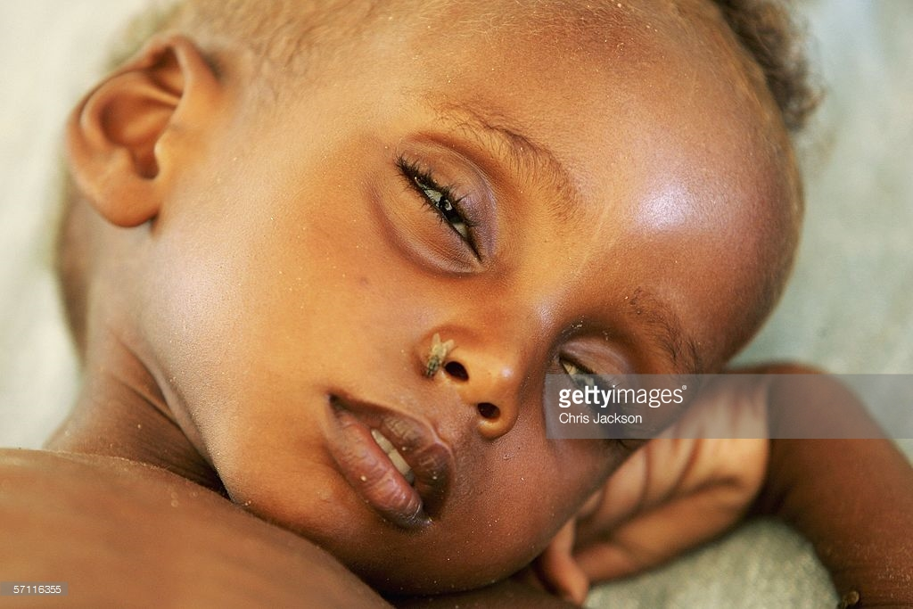
Country in Crisis
4,000 children die each year due to lack of access to safe water
Notes:
http://www.wateraid.org/au/where-we-work/page/tanzania

Slide 4
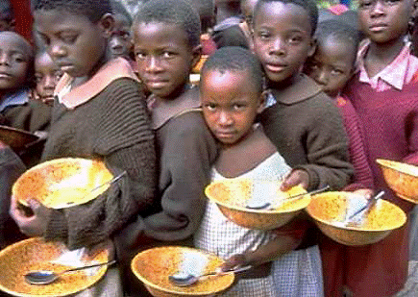
Country in Crisis
Without access to water, the people in Tanzania are unable to grow adequate food to eat, especially in years where rainfall is low.
Notes:
http://www.wateraid.org/au/where-we-work/page/tanzania

Slide 5
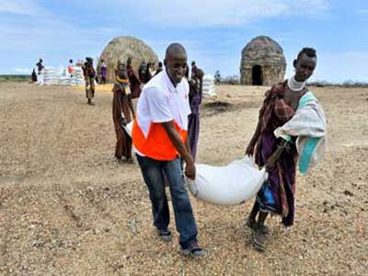
Country in Crisis
In 20131/2013 actual production of food grains was 435,000 tonnes below expected production
Notes:
http://www.theeastafrican.co.ke/news/2014--Poor-rainfall-and-shortage-of-food-for-Tanzania-/-/2558/1992662/-/ncm6jc/-/index.html

Slide 6
Solution??

Slide 7
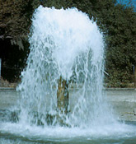
Let there be Water!
By making sure that all wells that are in need of repair are fixed in a timely manner, the government will be able to ensure that citizens have better and more consistent access to water for their various hydrous needs

Slide 8
How to do this?

Slide 9
Build a Model to Predict Need for Repair
The Taarifa Platform has provided important data describing many different characteristics of the wells in Tanzania and whether they are in need of repair or not.
Using this data, we will build a model to predict which wells need to be repaired.

Slide 10
Clean the Data
Significant Data cleaning was necessary and is more thoroughly described in the Final Report and need not be reiterated here.

Slide 11
Use Logistic Regression
The variable we want to predict is a binomial with values 0 (does not need repair) and 1 (needs repair)
Logistic regression, specifically a Generalized Linerar Model (glm) is most appropriate here

Slide 12
Model
RepairLog5 = glm(Status_Binom ~ gps_height + age + management_group_a + management_group_b + management_group_c + management_group_d + basin_1 + basin_2 + basin_3 + basin_4 + basin_5 + basin_6 + basin_7 + basin_8 + basin_9 + permit_1 + public_meeting_1 + extraction_type_class_1 + extraction_type_class_2 + extraction_type_class_3 + extraction_type_class_4 + extraction_type_class_5 + extraction_type_class_6 + extraction_type_class_7 + payment_type_1 + payment_type_2 + payment_type_3 + payment_type_4 + payment_type_5 + payment_type_6 + payment_type_7 + waterpoint_type_group_1 + waterpoint_type_group_2 + waterpoint_type_group_3 + waterpoint_type_group_4 + waterpoint_type_group_5 + waterpoint_type_group_6 + source_1 + source_2 + source_3 + source_4 + source_5 + source_6 + source_7 + source_8 + source_9 + source_10 + quantity_1 + quantity_2 + quantity_3 + quantity_4 + quantity_5, family = binomial, data = dataTest)

Slide 13
Use Model to Predict
predict_repair = predict(RepairLog5, type = "response")
table(dataTest$Status_Binom, predict_repair > t) where 0 < t <1.0 in increments of 0.1

Slide 14
Determine which Predictions at Each Threshold
table(dataTest$Status_Binom, predict_repair > 0.1)
table(dataTest$Status_Binom, predict_repair > 0.2)
table(dataTest$Status_Binom, predict_repair > 0.3)
table(dataTest$Status_Binom, predict_repair > 0.4)
table(dataTest$Status_Binom, predict_repair > 0.5)
table(dataTest$Status_Binom, predict_repair > 0.6)
table(dataTest$Status_Binom, predict_repair > 0.7)
table(dataTest$Status_Binom, predict_repair > 0.8)
table(dataTest$Status_Binom, predict_repair > 0.9)

Slide 15
Determine Which Threshold is Most Accurate
accuracyTest0.1 = (439+3683)/(439+4487+22+3683)
accuracyTest0.2 = (1474+3487)/(1474+218+3487+3452)
accuracyTest0.3 = (2854+3073)/(2854+3073+632+2072)
accuracyTest0.4 = (3811+2470)/(3811+2470+1115+1235)
accuracyTest0.5 = (4282+2068)/(4282+2068+644+1637)
accuracyTest0.6 = (4593+1688)/(4593+333+2017+1688)
accuracyTest0.7 = (14767+1466)/(14767+1466+159+2239)
accuracyTest0.8 = (4850+1263)/(4853+1263+76+2442)
accuracyTest0.9 = (4896+945)/(4896+945+30+2760)

Slide 16
Determine Which Threshold is Most Accurate
accuracyTest0.1 >0.4775808
accuracyTest0.2 > 0.5747886
accuracyTest0.3 > 0.6867107
accuracyTest0.4 > 0.7277256
accuracyTest0.5 > 0.7357201
accuracyTest0.6 > 0.7277256
accuracyTest0.7 > 0.8712898
accuracyTest0.8 > 0.7080148
accuracyTest0.9 > 0.6767466

Slide 17
Findings
Threshold level of 0.5 is most accurate with an prediction accuracy of 73.6%
Age of the well is very significant in predicting whether or not a given well needs repair.
The basins where the well water comes from also prove to be significant in determining the need for repair
Quantity of Water is highly significant in predictions

Slide 18
Recommendations
Further examine the impact that age of the well has on the functional status. Learning more about the relationship between age and functional status can help us better predict whether a given well will need repairing
Further examine the effect that the basin which the well is drawing water from has on the functional status. Specifically, Basin 7 and Basin 8 should be investigated for common characteristics that might contribute to poor well function.
Finally, further examine the relationship that the quantity of water at each waterpoint has on the need for it to be repaired. These variables all turned out to be very significant.

